Slide 1


Slide 2


Emotion Recognition for User Reactions to Video Content
Objective: Develop an application to recognize and analyze user emotions in real-time while watching video content.
Key Features:
Choice of camera input (desktop or smartphone)
Real-time facial landmark detection
Emotion classification based on Action Units (AUs)
Technologies Used:
OpenCV, MediaPipe, CNNs, Choice Trees

Slide 3


-
Emotion Recognition for User Reactions to Video Content
System Architecture
Objective: Develop an application to recognize and analyze user emotions in real-time while watching video content.
Key Features:
Choice of camera input (desktop or smartphone)
Real-time facial landmark detection
Emotion classification based on Action Units (AUs)
Technologies Used:
OpenCV, MediaPipe, CNNs, Choice Trees
Components:Input Options: Desktop Camera, Smartphone Camera (IP Webcam)
Processing Modules: Image Processing, Landmark Tracking, Emotion Detection
Data Storage: CSV Files
Output: Emotion Labels
System Diagramm
Modellierung
camera input
OpenCV
MediaPipe
CSV storage
ArchiMate verwendet Elemente und Beziehungen, um komplexe Architekturen zu modellieren.
Verschiedene Sichten ermöglichen spezifische Analysen je nach Stakeholder-Anforderungen.
Beispiel: Ein einfaches Modell einer Geschäftsprozessverwaltung.
CNN processing
SVC
processing
Video Content
Emotion Classification
Output

Slide 4
System Architecture
Components:Input Options: Desktop Camera, Smartphone Camera (IP Webcam)
Processing Modules: Image Processing, Landmark Tracking, Emotion Detection
Data Storage: CSV Files
Output: Emotion Labels
System Diagramm
Data Capture
camera input
OpenCV
MediaPipe
CSV storage
Camera Input Options:
Desktop Camera: Direct integration via OpenCV
Smartphone Camera: IP Webcam integration for flexibility
Implementation:
Utilizing OpenCV to access and manage camera feeds
User Choice:
Simple interface to switch between input sources
CNN processing
SVC
processing
Video Content
Emotion Classification
Output

Slide 5
System Diagramm
Data Capture
camera input
OpenCV
MediaPipe
CSV storage
Camera Input Options:
Desktop Camera: Direct integration via OpenCV
Smartphone Camera: IP Webcam integration for flexibility
Implementation:
Utilizing OpenCV to access and manage camera feeds
User Choice:
Simple interface to switch between input sources
CNN processing
SVC
processing
Video Content
Emotion Classification
Output

Slide 6

Benefits:Enhanced processing speed
Improved real-time performance
Image Processing with OpenCV
Purpose:Optimize images to reduce computation time
Techniques Applied:Image resizing, normalization and color channel change
Frame rate adjustment
Facial Landmark Tracking with MediaPipe
Functionality:Detect and track facial landmarks in real-time
Key Landmarks:Focus on landmarks relative to the nose for consistency
Visualization: Display of tracked landmarks on video feed (optional screenshot)
Implementation:Integration of MediaPipe for efficient landmark detection

Slide 7
Benefits:Enhanced processing speed
Improved real-time performance
Image Processing with OpenCV
Purpose:Optimize images to reduce computation time
Functionality:Detect and track facial landmarks in real-time
Facial Landmark Tracking with MediaPipe
Techniques Applied:Image resizing, normalization and color channel change
Frame rate adjustment
Key Landmarks:Focus on landmarks relative to the nose for consistency
Implementation:Integration of MediaPipe for efficient landmark detection
Visualization: Display of tracked landmarks on video feed (optional screenshot)
Parallel Processing: Simultaneous script to read and process CSV data every 5 seconds
Data Storage and Management
Frame Saving: Capture and save a frame every 3 seconds
CSV Logging: Store extracted landmarks relative to the nose in a CSV file
Diagram/Table: Store image path, label, action units and landmarks

Slide 8
Functionality:Detect and track facial landmarks in real-time
Facial Landmark Tracking with MediaPipe
Key Landmarks:Focus on landmarks relative to the nose for consistency
Implementation:Integration of MediaPipe for efficient landmark detection
Visualization: Display of tracked landmarks on video feed (optional screenshot)
Parallel Processing: Simultaneous script to read and process CSV data every 5 seconds
Data Storage and Management
Frame Saving: Capture and save a frame every 3 seconds
CSV Logging: Store extracted landmarks relative to the nose in a CSV file
Diagram/Table: Store image path, label, action units and landmarks

Slide 9
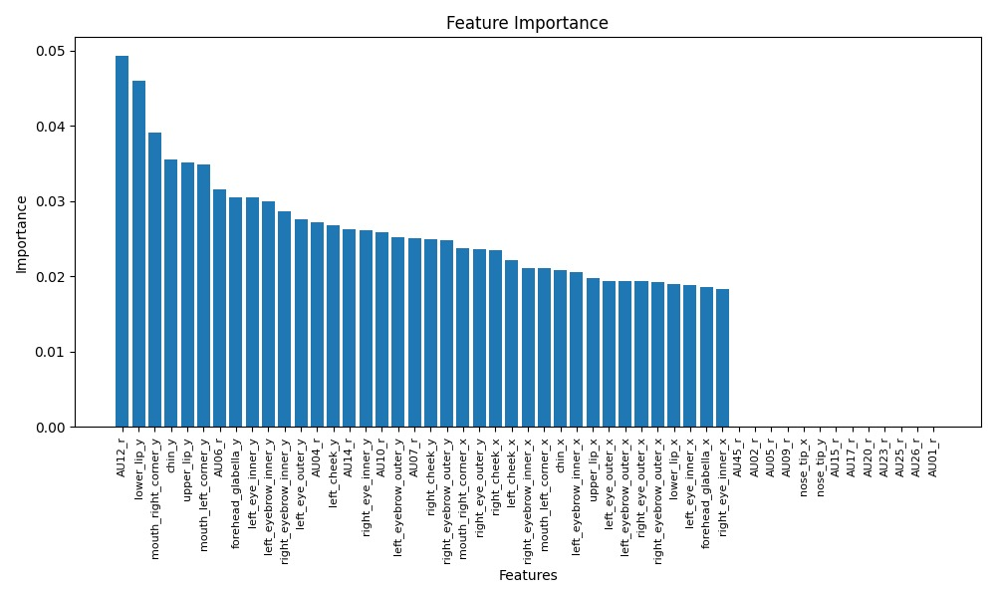

Slide 10
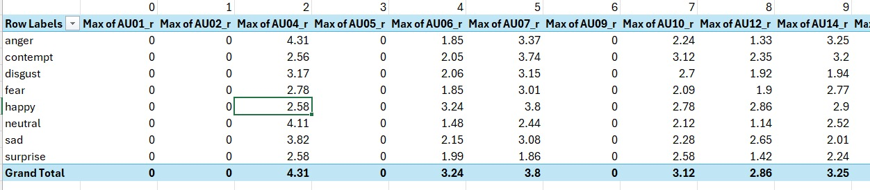

Slide 11
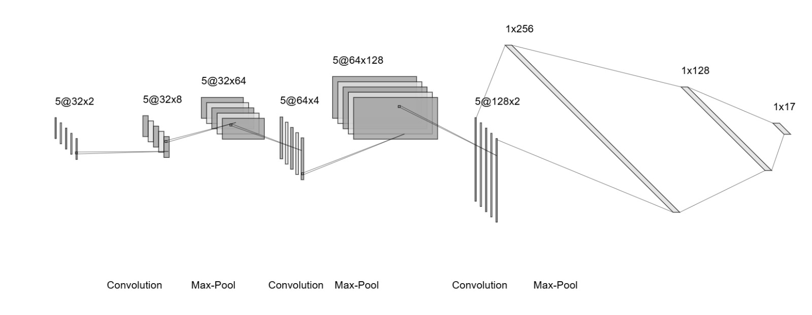

Slide 12
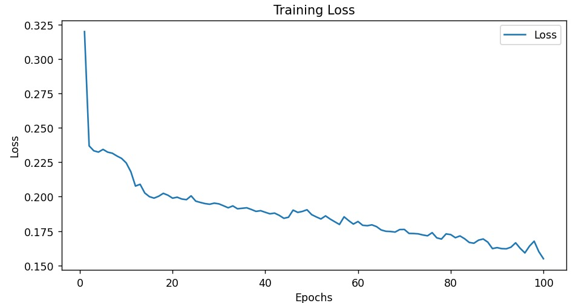
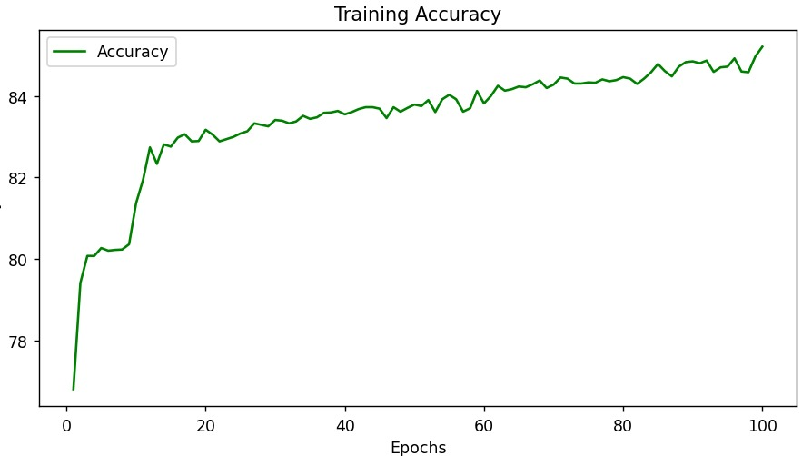
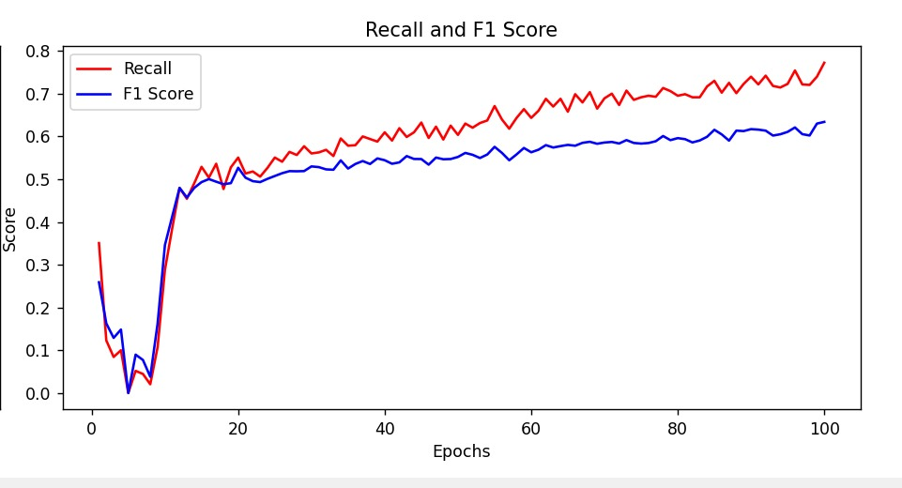
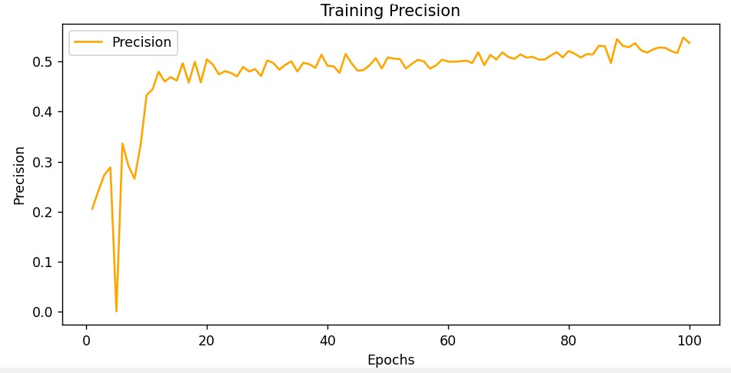

Slide 13
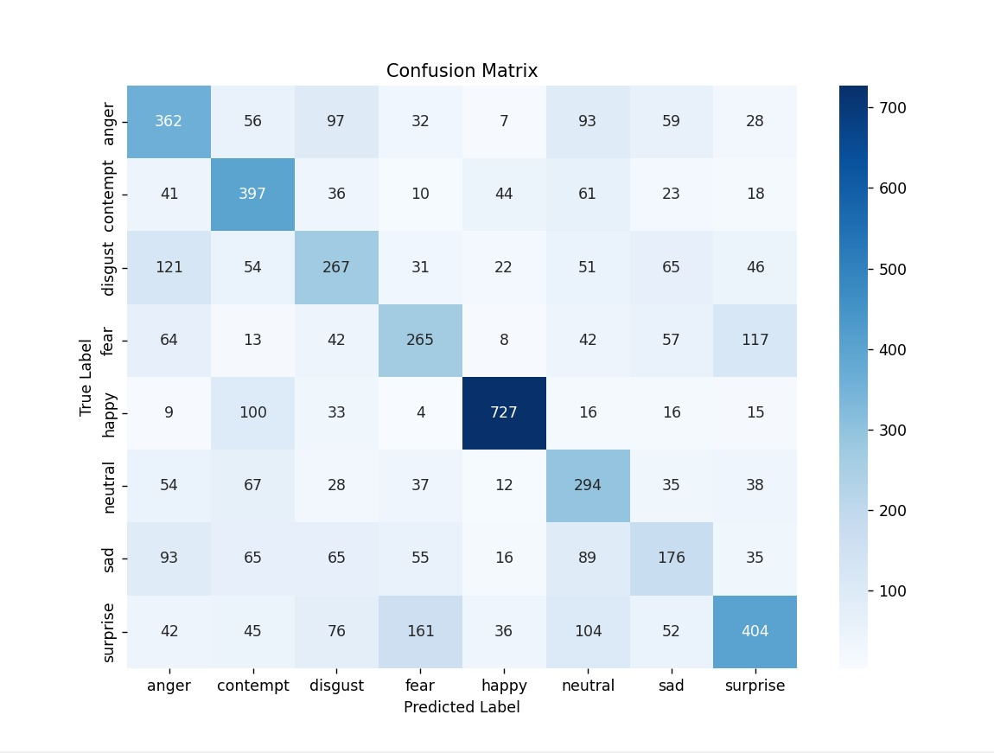
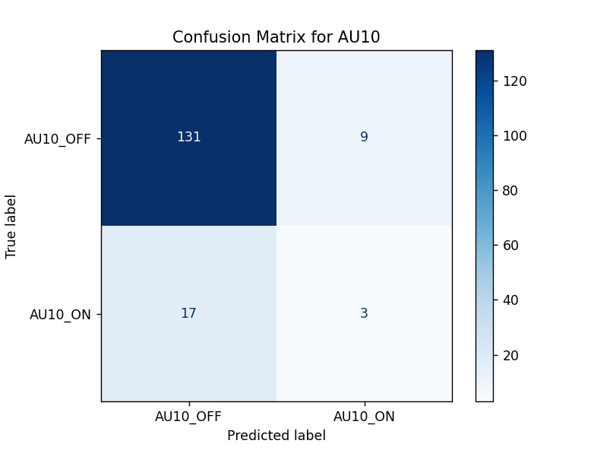
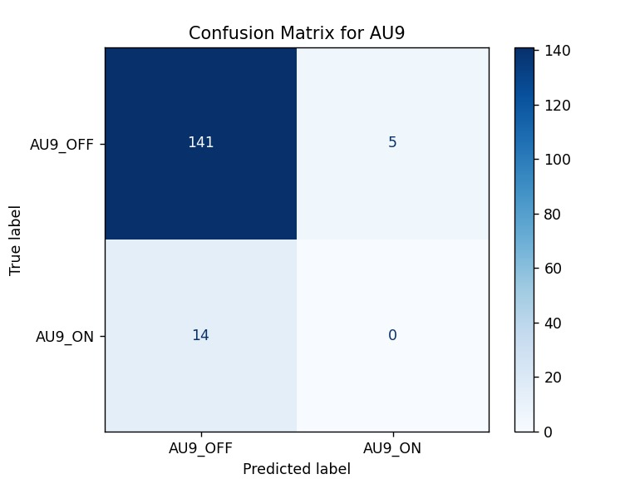

Slide 14
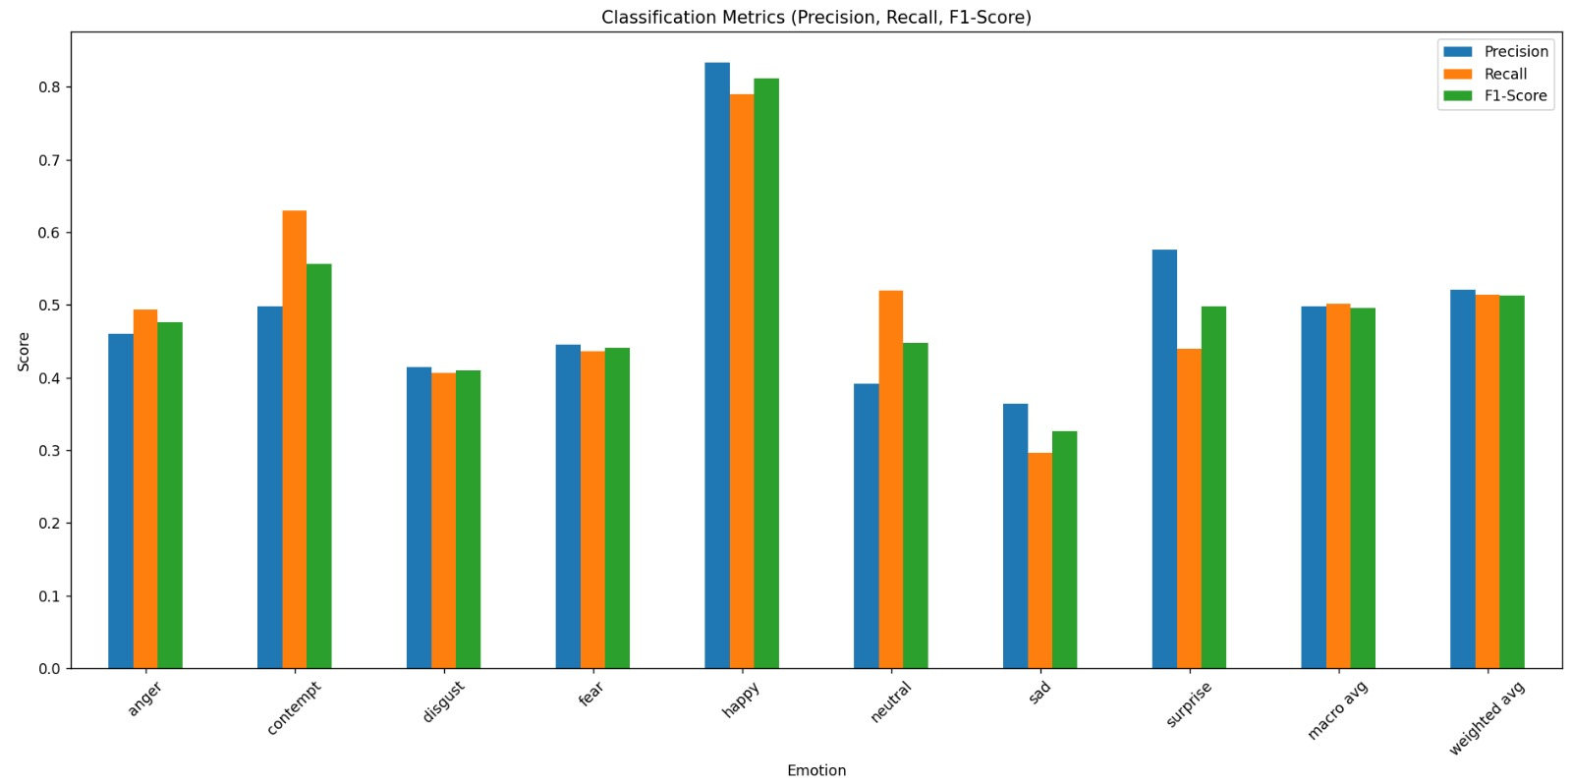

Slide 15
Emotion Classification Pipeline
Step 1: CNN Processing
Input: Landmark data (x,y coordinates)
Output: Binary values indicating active AUs (0 or 1)
Step 2: Choice Tree Analysis
Evaluate combinations of active AUs
Determine corresponding emotion
Output:
Emotion label
Step 4: SVC Processing
Input: Landmark data (x,y coordinates)
Output: Decision functions to which we apply Softmax, obtaining probabilities
Step 5: Combining results
Evaluate the combined result of the previous channels’ emotion classification
Input: Arrays of emotion probabilities
Output:
Emotion Label

Slide 16

THANK YOU VERY MUCH FOR YOUR ATTENTION
Project by Geanovu Medeea,Gheorghe Octavian,Tibrea Mihai

